Slide 1
Query
1. For creating database: - create database db_name;
if we run this query again than this error will come: -
Msg 1801, Level 16, State 3, Line 1
Database 'db_try' already exists. Choose a different database name
2. For using database: - use db_name;

Slide 2
Query: -
To know how many tables are in current database use following query: - select * from sys.tables;
To see table description:- First select table name then use command alt + fn + f1
To execute a query: - Ctrl + E or Fn + F5
Imp points: - ALTER TABLE only allows columns to be added that can contain nulls, or have a DEFAULT definition specified
To know complete description of any database object (Table, cursor, triggers, stored procedure): -
sp_help database_object_name

Slide 3
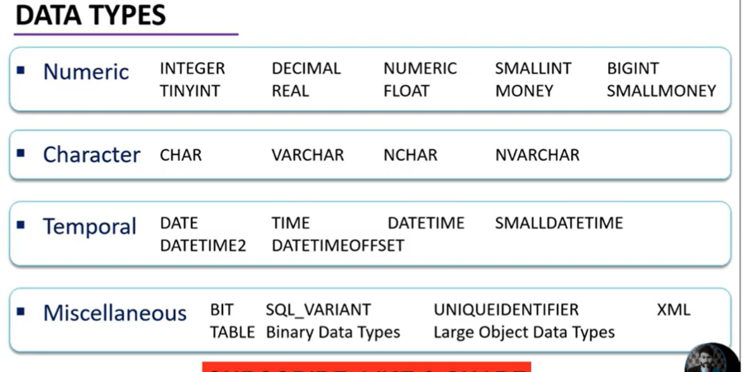
DATA TYPES

Slide 4
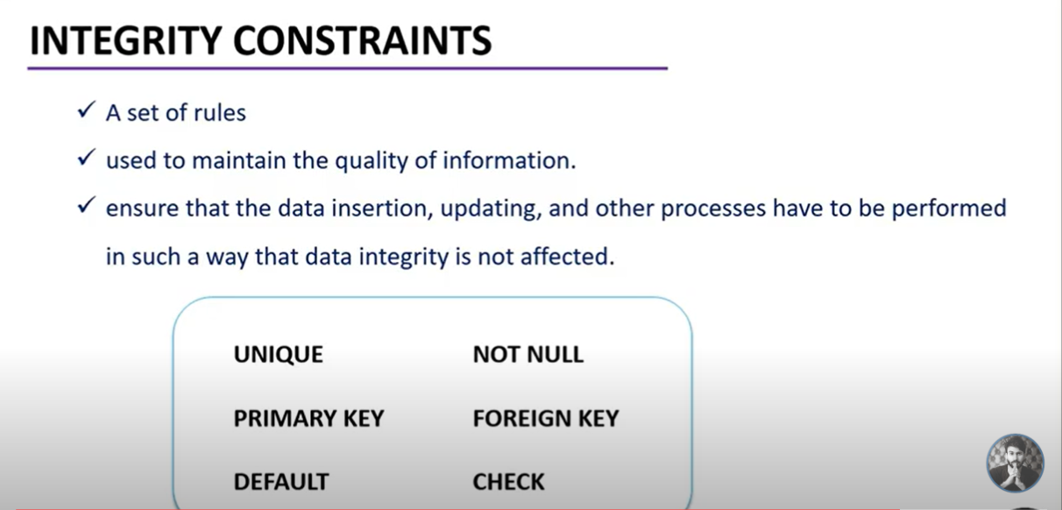
INTEGRITY CONSTRAINTS: -
It is used to ensure accuracy and consistency of data in a relational database.
It is a set of rules that database is not permitted to violate.

Slide 5
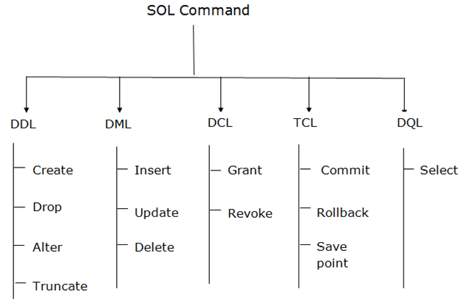
Statements:-
DDL
DML
DCL
TCL

Slide 6
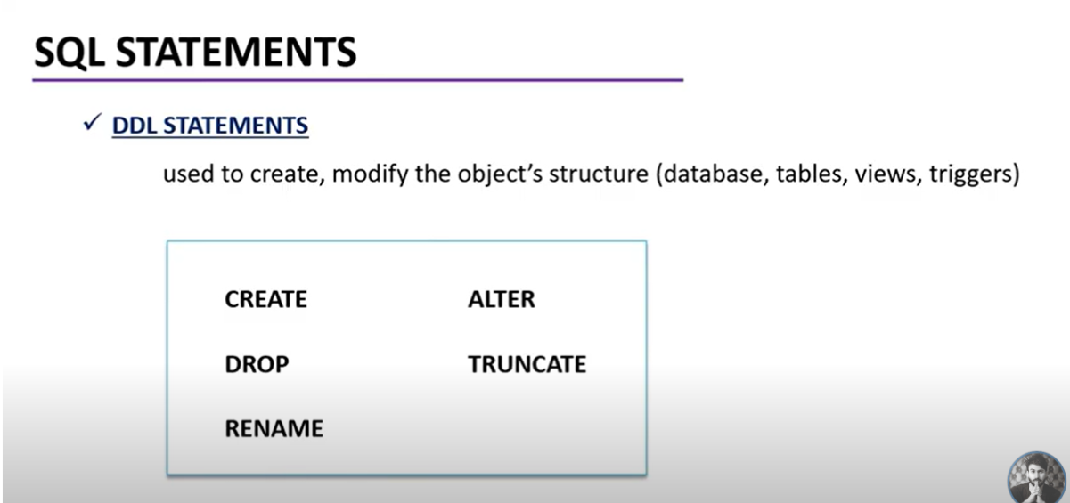
DDL :-

Slide 7
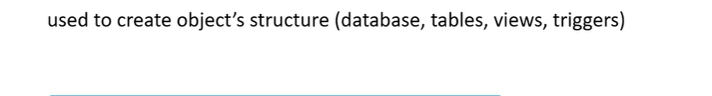
1. CREATE: -
create database db_name;
create table tb_name (column_name datatype constraints, column_name datatype constraints, column_name datatype constraints, column_name datatype constraints);
Example: -
create database db_try;
use db_try;
create table emp_try (emp_id int primary key,emp_name varchar(100), department varchar(50), contact_no bigint, emaild_id varchar(100), emphead_id int);

Slide 8
Creating table with foreign key constraints
Query: - create table std_sub(sub_id int primary key, sub_name varchar(30), teacher_id int FOREIGN KEY REFERENCES try_teacher(teacher_id))

Slide 9
2. DROP: -
DROP is a DDL command used to delete/remove the database objects from the SQL database. We can easily remove the entire table, view, or index from the database using this DDL command.
Syntax to remove a database: DROP DATABASE Database_Name;
Syntax to remove a table: DROP TABLE Table_Name;
Syntax to remove an index: DROP INDEX Index_Name;
Syntax to remove a view: DROP VIEW View_Name;
Example: - Drop Database Db_try;

Slide 10
3. ALTER: -
ALTER is a DDL command which changes or modifies the existing structure of the database, and it also changes the schema of database objects.
We can also add and drop constraints of the table using the ALTER command.
Syntax to add a new field in the table:
ALTER TABLE table_ name ADD column_name datatype;
Syntax to remove a column from the table:
ALTER TABLE table_ name DROP Column_Name_1 , column_Name_2 , ….., column_Name_N;
Syntax to modify the column of the table:
ALTER TABLE table_name MODIFY ( column_name column_datatype(size));
Syntax to rename a column in the table:
ALTER TABLE table_name RENAME COLUMN old_name to new_name;

Slide 11
ALTER TABLE - ALTER/MODIFY DATATYPE
To change the data type of a column in a table, use the following syntax:
1.
Ex: - ALTER TABLE try_std ALTER COLUMN phone_number bigint;
2. My SQL / Oracle (prior version 10G):
ALTER TABLE table_name MODIFY COLUMN column_name datatype;
3. Oracle 10G and later:
ALTER TABLE table_name MODIFY column_name datatype;
SQL Server / MS Access:
ALTER TABLE table_name ALTER COLUMN column_name datatype;

Slide 12
4. Truncate: -
TRUNCATE is another DDL command which deletes or removes all the records from the table.
This command also removes the space allocated for storing the table records.
Syntax of TRUNCATE command
TRUNCATE TABLE Table_Name;

Slide 13
Difference between drop and truncate: -
S.NO | DROP | TRUNCATE
1. | The DROP command is used to remove table definition and its contents. | Whereas the TRUNCATE command is used to delete all the rows from the table.
2. | In the DROP command, table space is freed from memory. | While the TRUNCATE command does not free the table space from memory.
3. | The structure of the table does not exist. | While the structure of the table exist.
4. | It is slow as compared to the TRUNCATE command. | While this command is faster than DROP.
5. | In the DROP command, integrity constraints will be removed. | While in this command, integrity constraints will not be removed.

Slide 14
5. Rename: -
RENAME is a DDL command which is used to change the name of the database table.
Syntax of RENAME command
RENAME TABLE Old_Table_Name TO New_Table_Name;

Slide 15
DML: -
USED TO INSERT, MODIFY, REMOVE THE EXISTING DATA FROM TABLES
INSERT UPDATE
DELETE

Slide 16
Insert: -
INSERT allows users to insert data in database tables.
Syntax of INSERT Command
INSERT INTO TABLE_NAME ( column_Name1 , column_Name2 , column_Name3 , .... column_NameN )

Slide 17
Update: -
UPDATE is another most important data manipulation command in Structured Query Language, which allows users to update or modify the existing data in database tables.
Syntax of UPDATE Command
UPDATE Table_name SET [column_name1= value_1, ….., column_nameN = value_N] WHERE CONDITION

Slide 18
DELETE: -
DELETE DML Command
DELETE is a DML command which allows SQL users to remove single or multiple existing records from the database tables.
This command of Data Manipulation Language does not delete the stored data permanently from the database. We use the WHERE clause with the DELETE command to select specific rows from the table.
Syntax of DELETE Command
DELETE FROM Table_Name WHERE condition;

Slide 19
Delete Vs Truncate: -
Delete | Truncate
The DELETE command is used to delete specified rows(one or more). | While this command is used to delete all the rows from a table.
It is a DML(Data Manipulation Language) command. | While it is a DDL(Data Definition Language) command.
There may be a WHERE clause in the DELETE command in order to filter the records. | While there may not be WHERE clause in the TRUNCATE command.
DELETE command is slower than TRUNCATE command. | While the TRUNCATE command is faster than the DELETE command.
The delete can be used with indexed views. | Truncate cannot be used with indexed views.
This command can also active trigger. | This command does not active trigger.
DELETE statement occupies more transaction spaces than Truncate. | Truncate statement occupies less transaction spaces than DELETE.

Slide 20
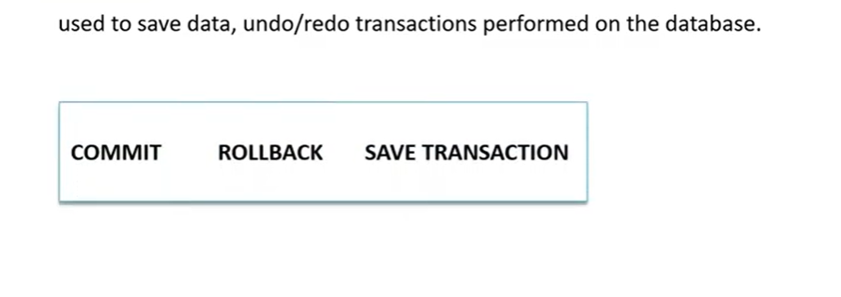
TCL: -

Slide 21
COMMIT: -
COMMIT command in SQL is used to save all the transaction-related changes permanently to the disk. Whenever DDL commands such as INSERT, UPDATE and DELETE are used, the changes made by these commands are permanent only after closing the current session. So before closing the session, one can easily roll back the changes made by the DDL commands. Hence, if we want the changes to be saved permanently to the disk without closing the session, we will use the commit command.
Syntax: COMMIT;

Slide 22
SAVEPOINT: -
We can divide the database operations into parts. For example, we can consider all the insert related queries that we will execute consecutively as one part of the transaction and the delete command as the other part of the transaction. Using the SAVEPOINT command in SQL, we can save these different parts of the same transaction using different names. For example, we can save all the insert related queries with the savepoint named INS. To save all the insert related queries in one savepoint, we have to execute the SAVEPOINT query followed by the savepoint name after finishing the insert command execution.
Syntax:
SAVEPOINT savepoint_name;

Slide 23
ROLLBACK:-
While carrying a transaction, we must create savepoints to save different parts of the transaction. According to the user's changing requirements, he/she can roll back the transaction to different savepoints. Consider a scenario: We have initiated a transaction followed by the table creation and record insertion into the table. After inserting records, we have created a savepoint INS. Then we executed a delete query, but later we thought that mistakenly we had removed the useful record. Therefore in such situations, we have an option of rolling back our transaction. In this case, we have to roll back our transaction using the ROLLBACK command to the savepoint INS, which we have created before executing the DELETE query.
Syntax:
ROLLBACK TO savepoint_name;

Slide 24
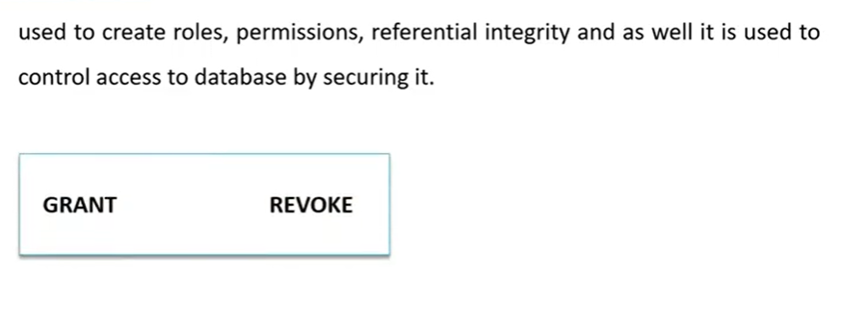
DCL: -

Slide 25
GRANT: -
This command gives users access privileges to the database.
Syntax:
GRANT SELECT, UPDATE ON MY_TABLE TO SOME_USER, ANOTHER_USER;

Slide 26
REVOKE: -
This command withdraws the user’s access privileges given by using the GRANT command.
Syntax:
REVOKE SELECT, UPDATE ON MY_TABLE FROM USER1, USER2;

Slide 27
DQL: -
DQL is used to fetch the data from the database.
It uses only one command: SELECT
a. SELECT: This is the same as the projection operation of relational algebra. It is used to select the attribute based on the condition described by WHERE clause.
Syntax:
SELECT expressions FROM TABLES WHERE conditions;

Slide 28
Join: -
By using joins, you can retrieve data from two or more tables based on logical relationships between the tables.
In a JOIN query, a condition indicates how two tables are related:
Choose columns from each table that should be used in the join. A join condition indicates a foreign key from one table and its corresponding key in the other table.
Specify the logical operator to compare values from the columns like =, <, or >.

Slide 29
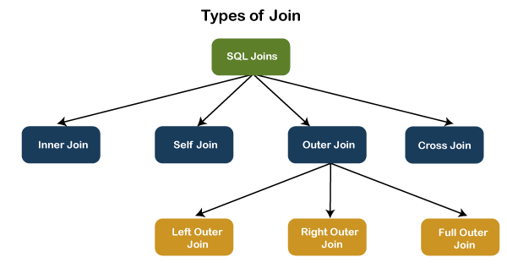
Types of Joins: -
SQL Server mainly supports four types of JOINS, The following are types of join supports in SQL Server:
INNER JOIN
SELF JOIN
CROSS JOIN
OUTER JOIN

Slide 30
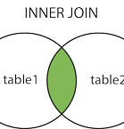
Inner Join: -
It selects records that have matching values in both tables.
Syntax: - SELECT column_name(s) FROM table1 INNER JOIN table2 ON table1.column_name = table2.column_name;

Slide 31
Self Join: -
A self join is a regular join, but the table is joined with itself.
Syntax: - SELECT column_name(s) FROM table1 T1, table1 T2 WHERE condition;
The SELF JOIN can be thought of as a JOIN of two copies of the same tables. We can do this with the help of table name aliases to assign a specific name to each table's instance. The table aliases enable us to use the table's temporary name that we are going to use in the query. It's a useful way to extract hierarchical data and comparing rows inside a single table.

Slide 32
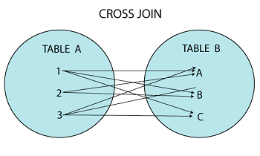
Cross Join: -
It's also known as CARTESIAN JOIN because it produces the Cartesian product of all linked tables. The Cartesian product represents all rows present in the first table multiplied by all rows present in the second table.
The below visual representation illustrates the CROSS JOIN. It will give all the records from table1 and table2 where each row is the combination of rows of both tables:
Syntax: - SELECT column_lists FROM table1 CROSS JOIN table2;

Slide 33
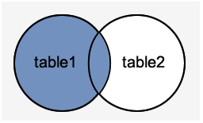
Left Outer Join: -
The LEFT OUTER JOIN retrieves all the records from the left table and matching rows from the right table. It will return NULL when no matching record is found in the right side table. Since OUTER is an optional keyword, it is also known as LEFT JOIN.
Syntax:-
SELECT column_lists FROM table1 LEFT JOIN table2 ON table1.column = table2.column;

Slide 34
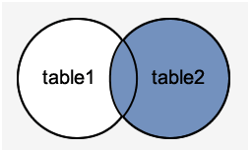
Right Outer Join: -
The RIGHT OUTER JOIN retrieves all the records from the right-hand table and matched rows from the left-hand table. It will return NULL when no matching record is found in the left-hand table. Since OUTER is an optional keyword, it is also known as RIGHT JOIN.
Syntax: - SELECT column_lists FROM table1 RIGHT [OUTER] JOIN table2 ON table1.column = table2.column;

Slide 35
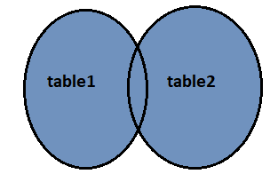
Full Outer Join: -
The FULL OUTER JOIN in SQL Server returns a result that includes all rows from both tables. The columns of the right-hand table return NULL when no matching records are found in the left-hand table. And if no matching records are found in the right-hand table, the left-hand table column returns NULL.
Syntax: - SELECT column_lists FROM table1 FULL [OUTER] JOIN table2 ON table1.column = table2.column;

Slide 36
Doubts
1. Cannot specify a column width on data type int. why????
create table try_std(std_id int(10) primary key, std_name varchar(50), phone_number int(10), address varchar(150), class int(2), stream varchar (15))
2. how to drop a constraints??
3. can we do full join using left join???
select s.*, t.* from std_sub s full join try_teacher t on s.teacher_id=t.teacher_id
select s.*, t.teacher_name from std_sub s full join try_teacher t on s.teacher_id=t.teacher_id
select s.*, t.teacher_name from std_sub s left join try_teacher t on s.teacher_id=t.teacher_id
select s.*, t.* from std_sub s left join try_teacher t on s.teacher_id=t.teacher_id
select * from try_teacher
select * from std_sub

